Slide 1
Seminar: Course A-Z
Self Driving Car
Changliang Sun
2018/03/30
2018
REPORT

Slide 2
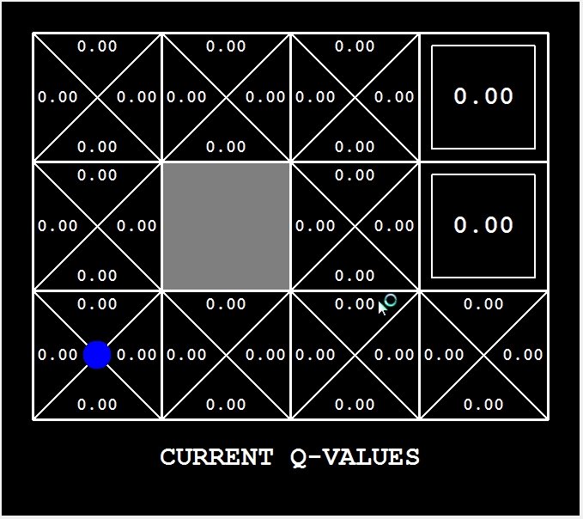
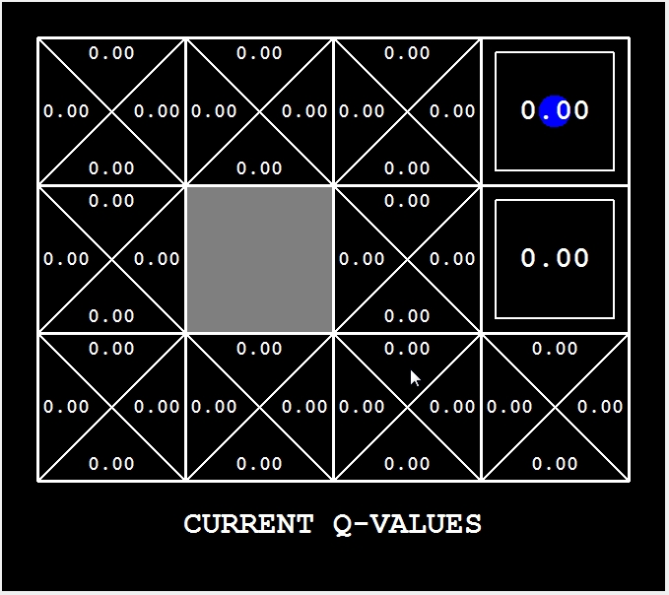
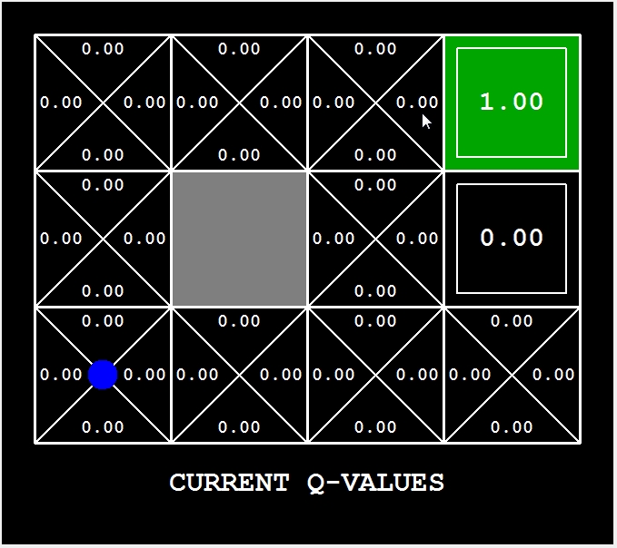

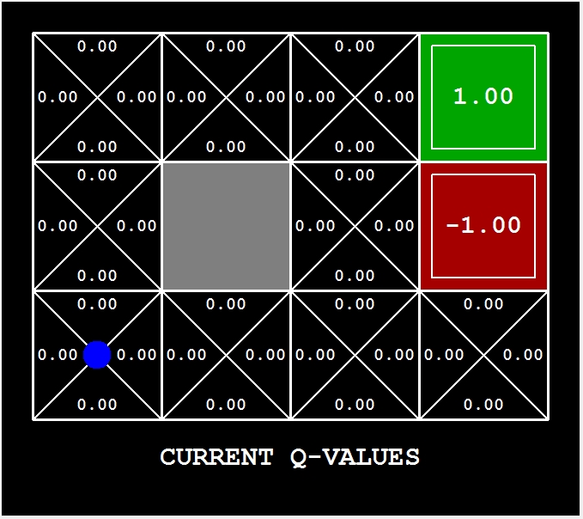
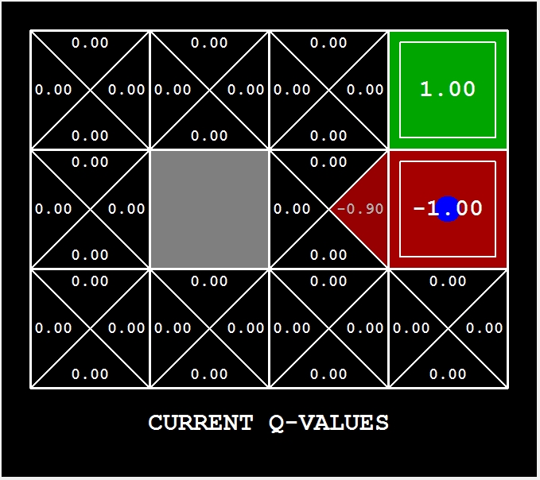
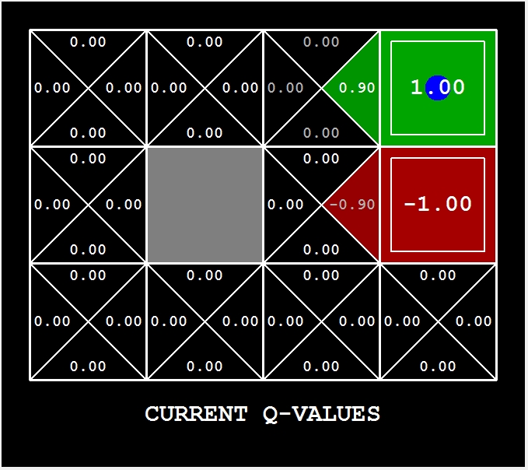
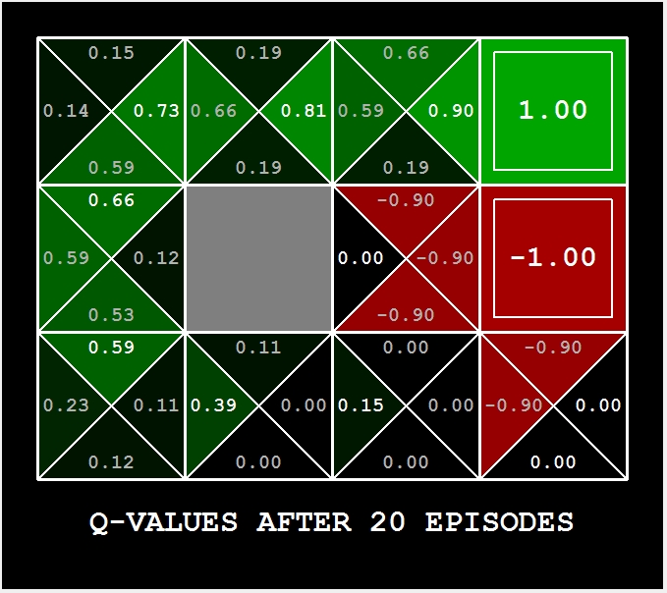
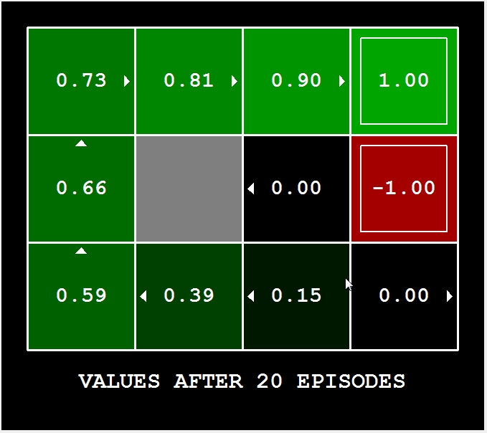

Q-Learning Review
Action(U,D,L,R)
Discount
Reward
Next state
State/Coord.

Slide 3
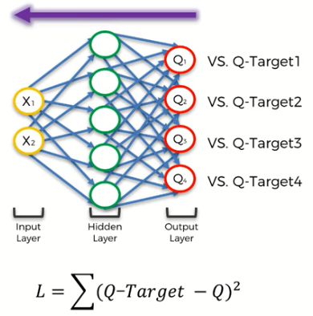
Deep Q-Learning

Slide 4
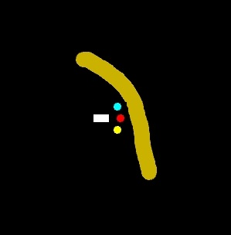
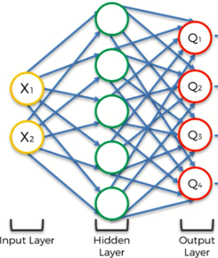
Deep Q-Learning
Signal: 3 sensors and 2 orientation
Goal: drive the car from downtown to airport
Action: forward, turn left 20 degrees, turn right 20 degree
Reward:
1, closer to the goal, get 0.1 reward;
2, drive in sand or out of boundary, get -1 reward;
3, drive one step, get -0.2 reword.
s
s’
max
a
Get reward
Q
Q’
random output
random output
loss
Q(target)
-1

